Slide 1
MODES OF 8086

Slide 2
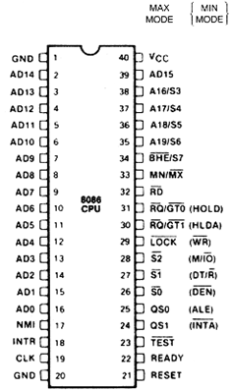
PIN CONFIGURATION

Slide 3
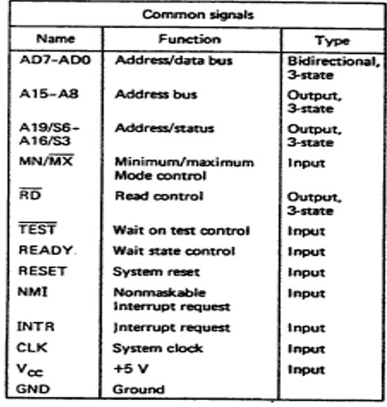

Slide 4
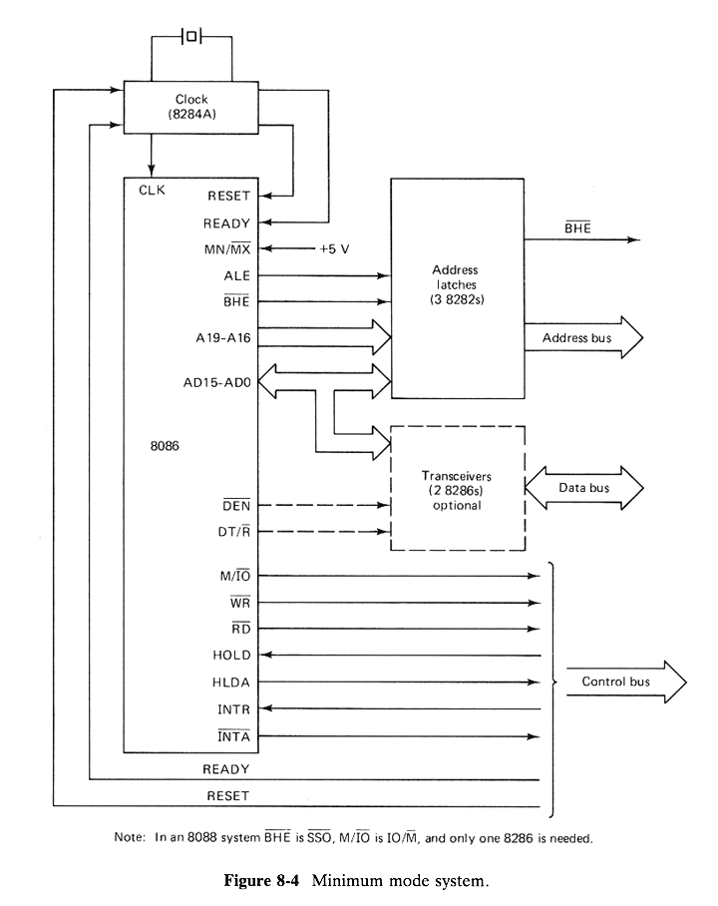
MINIMUM MODE SYSTEM

Slide 5
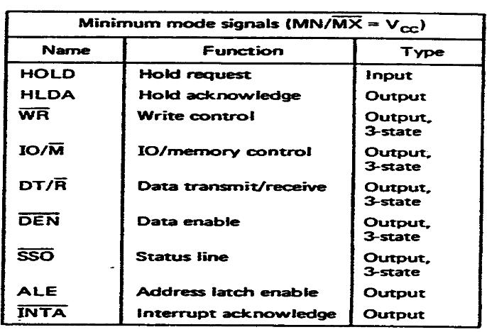

Slide 6
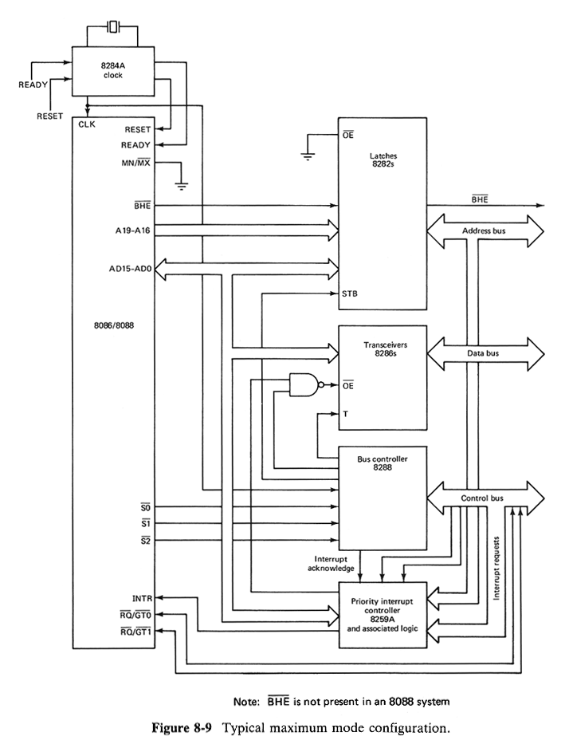
Maximum mode configuration

Slide 7
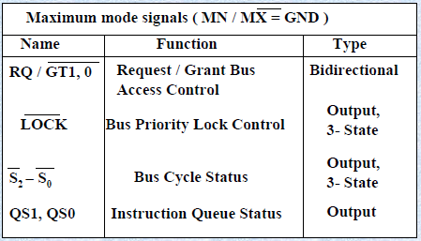

Slide 8
STATUS SIGNALS

Slide 9
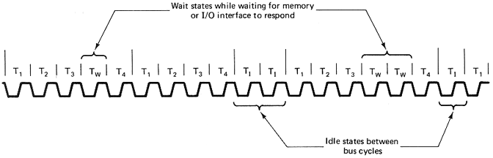
TYPICAL SEQUENCE OF BUS CYCLE

Slide 10
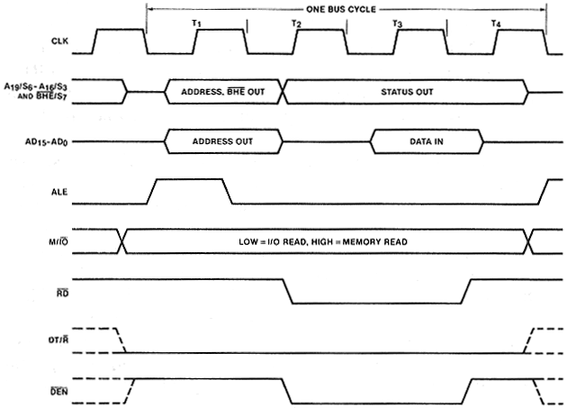
MINIMUM MODE BUS TIMING DIAGRAM-INPUT

Slide 11
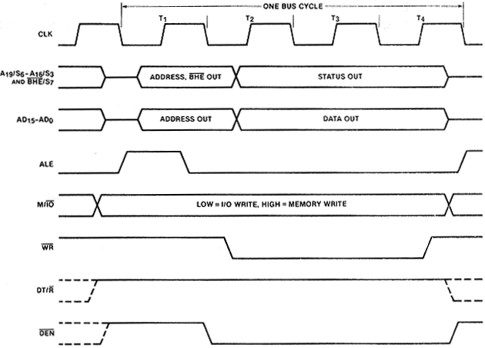
MINIMUM MODE BUS TIMING DIAGRAM-OUTPUT

Slide 12
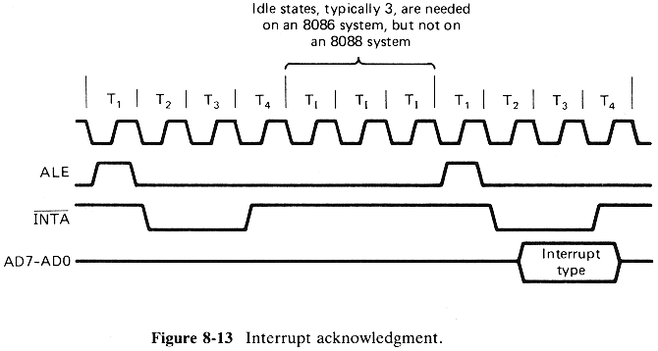
INTERRUPT ACKNOWLEDGEMENT

Slide 13
If an INTR is identified in the previous bus cycle and instruction has completed,a –ve pulse will be applied during current bus cycle and next clock cycle.
Each of these pulse extend from T2 to T4.
On second bus cycle,the INT device will put the type on AD7-AD0(T2-T4).

Slide 14
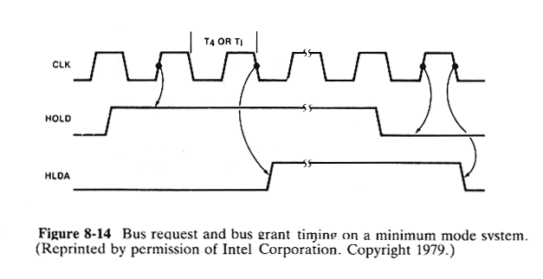
BUS REQUEST AND GRANT TIMING FOR MINIMUM MODE

Slide 15
At the rising edge of each clk pulse,8086 will check HOLD pin.
If HOLD request is received by 8086 during T1 or before T4,then CPU activates HLDA and succeeding clk pulses will be given to requesting master until master drops its request.
The lowered request is detected at the rising edge of next clk cycle and HLDA is dropped at the trailing edge of that clk cycle.

Slide 16
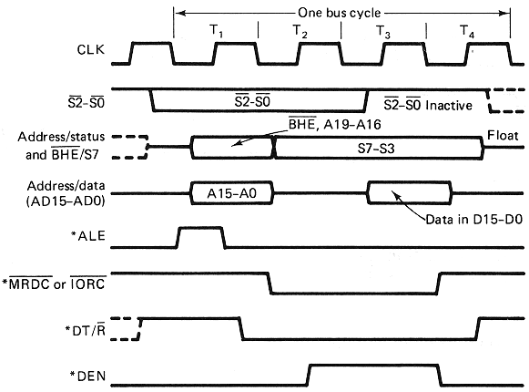
MAXIMUM MODE BUS TIMING DIAGRAM-INPUT

Slide 17
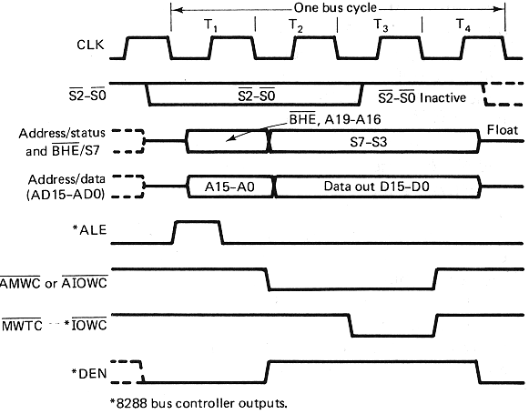
MAXIMUM MODE BUS TIMING DIAGRAM-OUTPUT

Slide 18
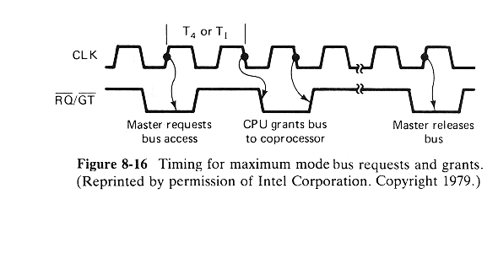
BUS REQUEST AND GRANT TIMING FOR MAXIMUM MODE

